Slide 1
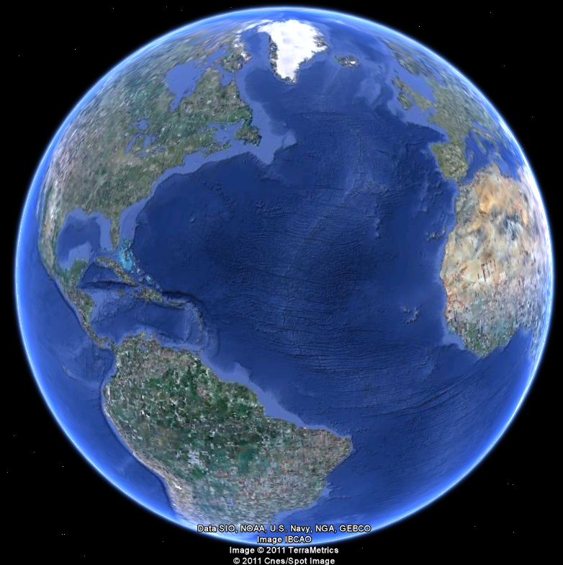
APEC 100 Sustainable Development
Randomized Controlled Trials

Slide 2

RCT Example: Collecting Court Fines
Problem: people in England too often fail to pay their court fines. End up sending a bailiff or police officer to their homes to collect.
How to collect fines in more cost-effective manner?
Use new approach – send text messages (low cost).
People randomly assigned to one of five groups:
No text message (control group)
Standard text message
Text including amount owed
Text including name
Text including amount AND name

Slide 3
Results
People were more likely to pay their late fines after receiving texts with their names.
Average value of payments increased over 30%.
If this method was used nationally, fine payments would increase by over £3 million annually.
Reduce need for police to make home visits!

Slide 4
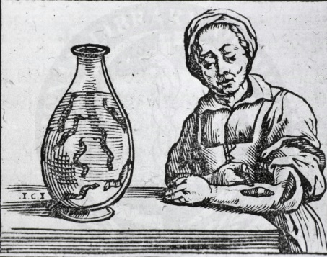
RCTs are Common in Other Arenas
Clinical trials, drug trials are now commonplace. Hard to believe that anyone ever argued they were unnecessary.
In internet sales, companies test which of two webpage designs are more successful in keeping people on the website, and clicking and buying.
Fairly simple to randomly assign website visitors to different website designs, and then track their clicks and buying behavior.
Many hundreds of RCTs have been, or are being, conducted in developing nations in context of education, health and anti-poverty programs.

Slide 5
Examples of RCTs in the Environmental Context
Effects of social comparisons, technical information and moral suasion on electricity & water use (U.S., S. Africa, Norway).
Effects of social comparisons on participation in payment for environmental service programs (U.S. Conservation Reserve Program).
Effects on drinking water consumption from potentially contaminated sources (arsenic in Bangladesh; chemical contaminants in U.S.).

Slide 6
Examples of RCTs
In-kind and in-cash performance payments in Bolivia at household-level to reduce deforestation
Randomization at the household level.
In-cash performance payments in Uganda at household-level to reduce deforestation
Randomization at the community level.
In-cash performance payments in Tanzania and Malawi to increase reforestation
Randomization at the household level.

Slide 7
3 Common Types of RCTs
Simple (complete) randomization
Randomized phase-in
Randomized encouragement

Slide 8
(1) Simple Randomization
Randomize eligible candidates into one or more treatment groups and a control group.
Easier when there are more eligible units than budget would permit to be assigned to treatment.

Slide 9
Simple Randomization: Example
Identify farmers eligible for and interested in new conservation incentive program.
Randomize these people into a treatment group that can access program and a comparison (‘control’) group that cannot access program.
Measure average difference in resource use between treatment and control group.

Slide 10
Example: Impact of Program Design
Jack (AEJ:Applied, 2012): Choice between allocating reforestation contracts in Malawi by an auction or a fixed take-it-or-leave-it price.
Outcomes: Trees planted, trees maintained
Sample: 400 eligible and interested farmers
Treatment Arms: Two contract groups: uniform-price auction or fixed, take-it-or-leave-it payment.
Uniform-price auction run first (incentive-compatible: no incentive to lie about reservation price)

Slide 11
Example: Impact of Program Design
Uniform price set in auction was offered to other treatment group (immediately after auction).
Uniform-price auction had much lower levels of participation and thus fewer trees planted.
However, uniform-price auction had higher levels of compliance with contract criteria and thus greater tree survival.

Slide 12
(2) Randomized Phase-in Program
Programs may express concern about ‘denying’ participants access to programs and can be uncomfortable with using randomization to establish a comparison group.
However, programs are often phased-in over time and have budgetary constraints.
In these cases, the program can select which candidates will enter the program first through a lottery among interested and eligible candidates.

Slide 13

(3) Randomized Encouragement
Randomization of the treatment is not the only way in which we can create experimental control.
Rather than randomize candidates into treatment and control groups, the project randomizes encouragement of candidates into the treatment group.
Encouraged units have a systematically higher probability of being exposed to the treatment because of a factor (encouragement) that does NOT affect the outcome, except by increasing probability of treatment exposure.
For the units whose exposure to the treatment is affected by encouragement (“compliers”), we can estimate the causal effect.

Slide 14
Water Efficiency Technology Adoption (Alpizar, Bernedo & Ferraro, In Progress)
Why don’t households adopt water-efficient technologies that financial calculations imply would save them money (cash on the table)?
How much water and money does the adoption of water efficient technology save?
Randomize information and subsidies (encouragement) to households in Costa Rica and measure adoption and changes in water use.

Slide 15
Ethical Issues and RCTs
What are the ethical concerns about conducting a RCT in your program to evaluate its performance?
What’s worse?
Denying landowners access to a program that lacks credible evidence of effectiveness.
or
Encouraging landowners to participate in a program when there is a possibility of adverse outcomes?

Slide 16
Favorable Conditions for RCTs
The intervention is well defined.
Intervention is popular. Results would have wide effects on agri-environmental policy beyond the program.
Possible replication at the state, regional, federal, or international levels
Sufficient number of units: individuals, farms, or conservation districts.
Importance of conducting a power analysis to estimate the sample size given the anticipated effect.
Factors that affect access to the intervention are well understood.
Access to the intervention is well controlled by the program implementers.

Slide 17
Favorable Conditions for RCTs
Final outcomes, or important intermediate outcomes, can be observed by the end of the project.
Outcomes across units are relatively independent or potential spillover effects can be built into the project design.
Opportunities exist to include program alternatives within the experimental project design
Results can inform best practice and reduce downside risk for program administrators.

Slide 18
Strong Candidates
Reaching out to new constituents
Introduction of new programs or new technologies
Certification programs
Incentive and lending programs
Information and technology transfer
Stakeholder participation
Policing and compliance auditing

Slide 19
Key Advantage: Explaining the Results
Data from experimental designs are easier to analyze: simple difference in means will often be sufficient.
Experimental designs permit the telling of simple stories to external audiences.
Randomization can appeal to policy makers because use of lotteries to assign program with limited resources is transparent and perceived as fair.

Slide 20
Potential Limitation of RCTs
Not always feasible or appropriate.
Things can go wrong
Bad luck: control group looks different from treatment group
Spillovers (units are not independent)
Non-compliance (treated units refuse treatment; control units get treatment; units disappear after treatment)
Hawthorne or John Henry biases
There are methods to address these problems.

